Slide 1

How has the automotive industry stock prices performed in 2020?
Contributors:
Melissa Smashey Mark Munanura Tiffany McGowan Matt Egan

Slide 2

•
With the COVID pandemic, we wanted to analyze the performance of automotive industries stock performance.
Given the stay-at-home order mandated by most if not all countries, we wanted to look at which manufacturers preformed best given these unusual circumstances.
Motivation

Slide 3
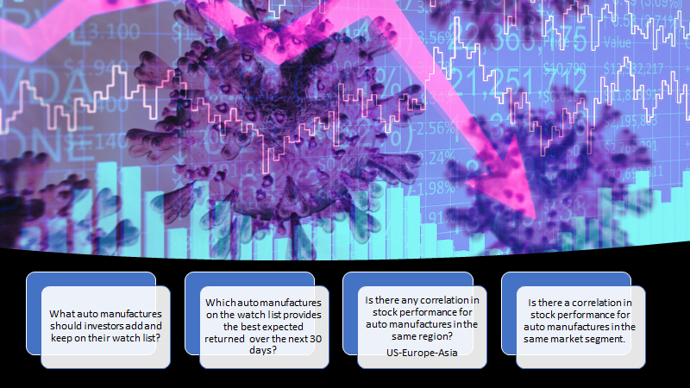

Slide 4

Quick Financial Lesson
Risk:
The chance that an outcome or investment's actual gains will differ from an expected outcome or return.
High Risk –Higher Return Low Risk – Lower Return
Adjusted Close Price:
Amends a stock's closing price to reflect that stock's value after accounting for any corporate action.
Makes it easier to evaluate stock performance.
Notes:
ash adjusted closing price factors in anything that might affect the stock price after the market closes. The adjusted closing price factors in corporate actions, such as stock splits, dividends, and rights offerings.
The main advantage of adjusted closing prices is that they make it easier to evaluate stock performance. Since successful stocks often split repeatedly, graphs of their performance would be hard to interpret without adjusted closing prices.

Slide 5
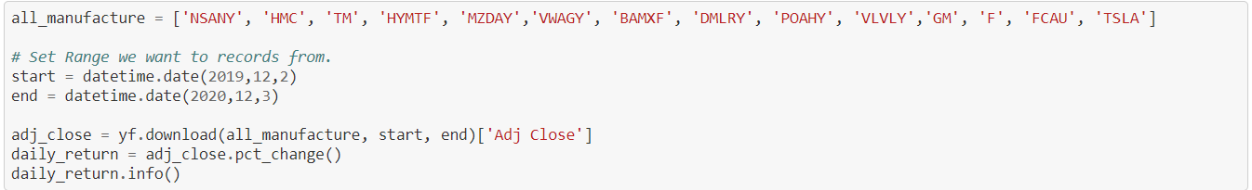
Data Cleanup
Data Source for the raw data
Yahoo Finance Module (yfiance)
Pulled 1 year of historical data
(12/2/19-12/3/20)
Open, High, Low, Close, Adjusted Close, Volume
Data list of stock ticker symbols to make the dataframe
Adjusted Close as the variable to measure stock performance
Used pandas pct_change() method to get the daily return for each stock
Dropna() from Daily Return column
Perform Analysis through Scatter plots, histograms, line graphs, correlation heatmaps
Notes:
1)We first had to install the Yfiance module into our jupyter notebooks. The data was really clean, we didnt have to do much adjustments.
2)We were able to narrow down the stocks historical data for the year timeframe.
3)The historical data contained for each stock was their open, high, low, close, adjusted close,and volume .
4) We created a list of stock ticker symbols to make the dataframe.
5) We decided to only focus on the adjusted close since that was the ideal variable to measure a stock’s performance.
6)We created a Daily returns column by using the pandas method pct_change(). We dropped any NAs within the columns to get a clean dataframe.
We created scatter plots, histograms, line graphs and correlation heatmaps to help answer our questions and catch some interesting findings along the way.
Mark will go over the findings in the next few slides.

Slide 6

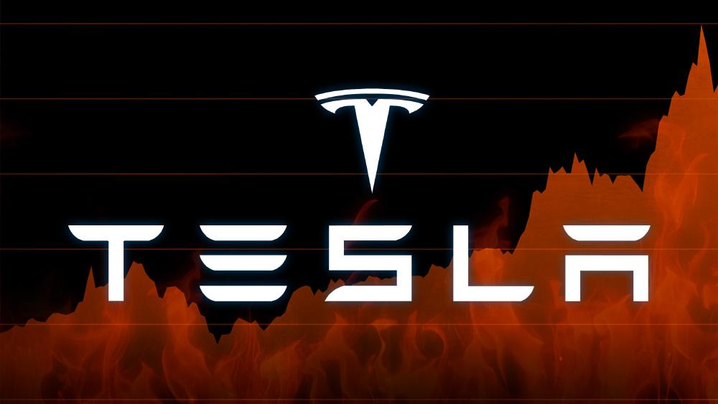
Interesting Findings
In March, COVID caused stock prices plummet nearly in half for all manufactures.
Tesla recovery quick recovery from COVID.

Slide 7
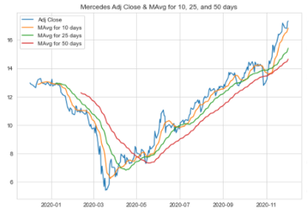
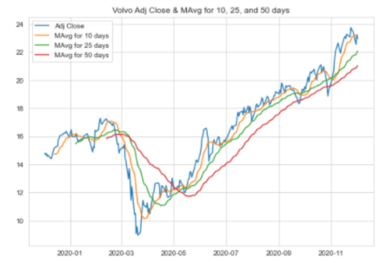
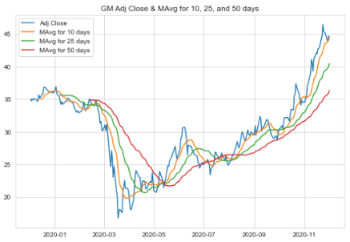
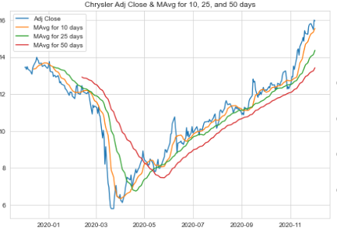
Notes:
Adjusted stock prices for the chosen manufacturers; each experienced the covid sell-off and then recovered to post better than pre-sell off returns. Moving averages were used to smooth out the volatility in the daily returns so variability in the stock would eliminate singular day movements that would skew the overall view.

Slide 8
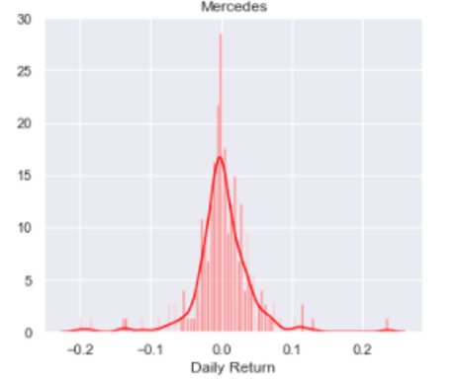
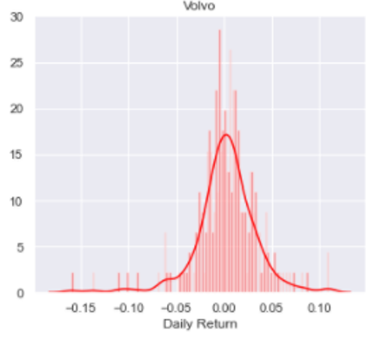
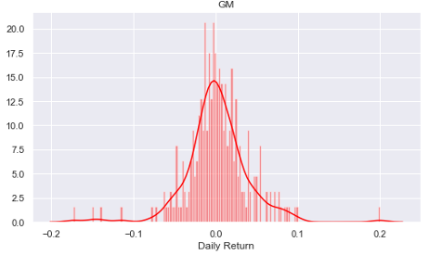
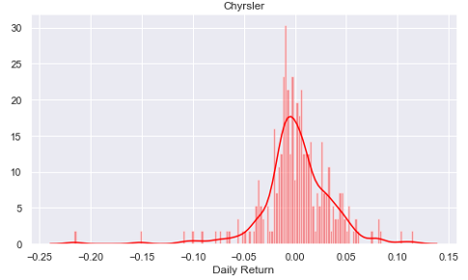
Notes:
The distribution of the daily returns helps with understanding the volatility (and subsequently the risk) associated with each of these stocks. It can also be used to infer differences in the responses of each of the stocks after the march sell-off. Both European manufacturers showed recovery by June and steady growth after (>20%); the American manufacturers took longer to respond and have experienced lower returns at 10%

Slide 9
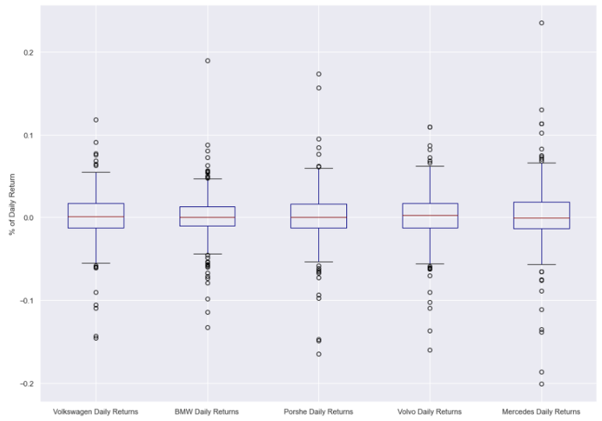
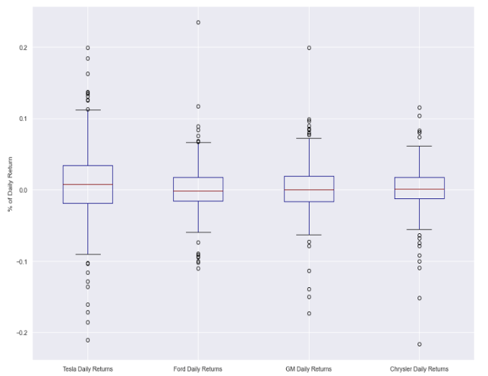
This shows the variability in the daily return.
Volvo shows a positive overall return on average compared to the other European manufacturers.
Tesla show a positive overall return on average compared to the other US manufacturers.
Overall Car companies have a near zero daily % return on average, with all showing rare significantly big movements.

Slide 10
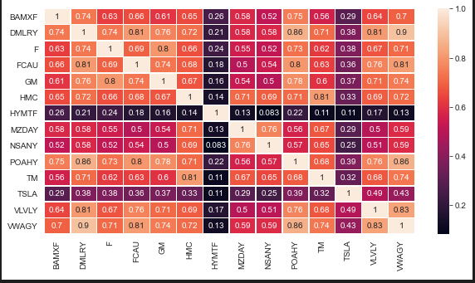
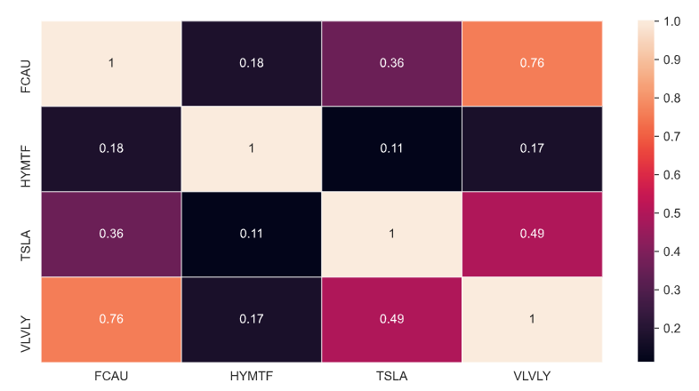
In these heat maps the darker the color the least the correlation between manufacturer region and their adjusted close price.

Slide 11
ASIA
Nissan | - | - | - | - | 1
Mazda | - | - | - | 1 | 0.76
Hyundai | - | - | 1 | 0.13 | 0.083
Toyota |  | 1 | 0.11 | 0.67 | 0.65
Honda | 1 | 0.81 | 0.14 | 0.71 | 0.69
 | Honda | Toyota | Hyundai | Mazda | Nissan
U.S.
GM | - | - | - | 1
Chrysler | - | - | 1 | 0.74
Ford | - | 1 | 0.69 | 0.80
Tesla | 1 | 0.38 | 0.36 | 0.37
 | Tesla | Ford | Chrysler | GM
Europe
BMW | - | - | - | - | 1
VW | - | - | - | 1 | 0.70
Porsche | - | - | 1 | 0.86 | 0.75
Volvo | - | 1 | 0.76 | 0.83 | 0.64
Mercedes | 1 | 0.81 | 0.86 | 0.90 | 0.74
 | Mercedes | Volvo | Porsche | VW | BMW
Notes:
Japanese based Asian manufacturers show a closer correlation in stock prices in comparison to their Korean peer (Hyundai). In the US the Detroit big 3’s stocks show a much closer relationship than their California based EV competition. European car stocks show a strong correlation across the board, with the German manufacturers showing very high correlation compared to their swedish counterpart. -- Proximity seems to drive the relationship as they’d probably face the same challenges and take advantage of the same strength by being located proximal to each other.

Slide 12
Between $35k and $60K
Above $60k
BMW | - | - | 1
Ford | - | 1 | 0.63
GM | 1 | 0.8 | 0.61
 | GM | Ford | BMW
Mercedes | - | - | 1
Porsche | - | 1 | 0.56
Tesla | 1 | 0.39 | 0.38
 | Tesla | Porsche | Mercedes
Below $35k
Chrysler | - | - | - | - | - | - | 1
Honda | - | - | - | - | - | 1 | 0.68
Hyundai | - | - | - | - | 1 | 0.14 | 0.18
Mazda | - | - | - | 1 | 0.13 | 0.71 | 0.50
Nissan | - | - | 1 | 0.76 | 0.083 | 0.69 | 0.54
Toyota | - | 1 | 0.65 | 0.67 | 0.11 | 0.81 | 0.63
VW | 1 | 0.74 | 0.59 | 0.59 | 0.13 | 0.72 | 0.81
 | VW | Toyota | Nissan | Mazda | Hyundai | Honda | Chrysler
Notes:
No concrete relationship / correlation can be inferred from the average prices of the cars sold by the company and the stock prices of companies selling within the same spend band / market segment. However manufacturers in the same market segment seem to share a loose relationship on average for vehicles below $60K; above $60K doesn’t show as much of a correlation.

Slide 13
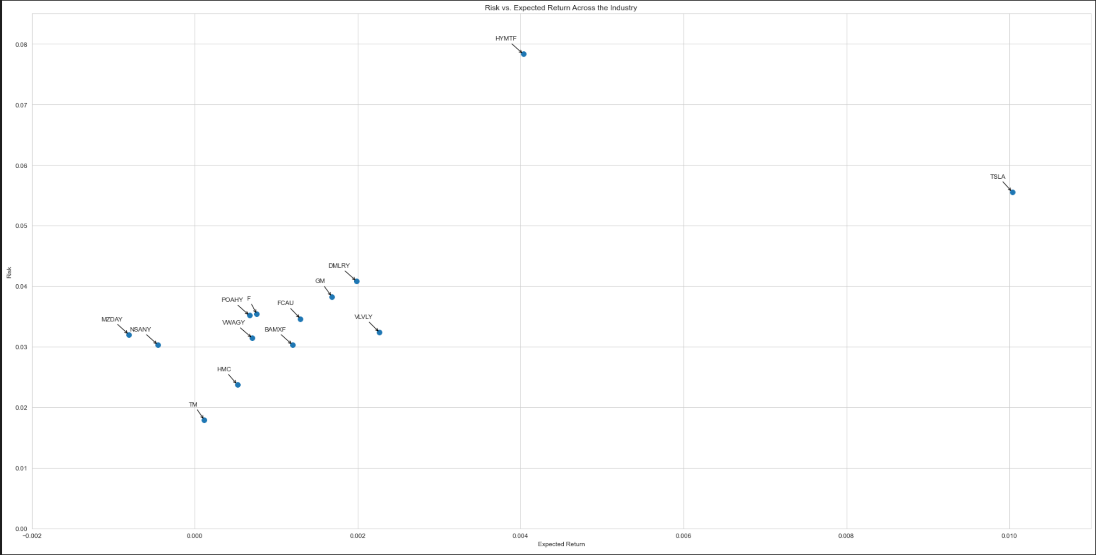
Notes:
Another way we look at the similarities in performance manufacturer performance was by plotting them out on a scatter diagram.

Slide 14

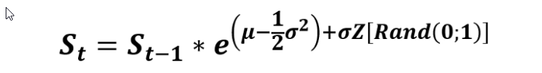
Brownian Motion / Wiener Process:
-Brownian motion is a stochastic process for modeling random behavior over time and has two major components
(Drift and Volatility)
Drift : In this use case is the direction rates of returns
have used in the past.
Volatility: Is the historical volatility multiplied by a
random normal variable.
Monte Carlo:
-Is a technique used to understand impact of risk/uncertainty when decision making.
-Runs thousands of trials with different random number generated from an underlying distribution.
-Principle is based of the law of large numbers
Notes:
Law of Large Numbers:
The law of large numbers states that as a sample size grows, it mean gets closer to the average of the whole population.

Slide 15
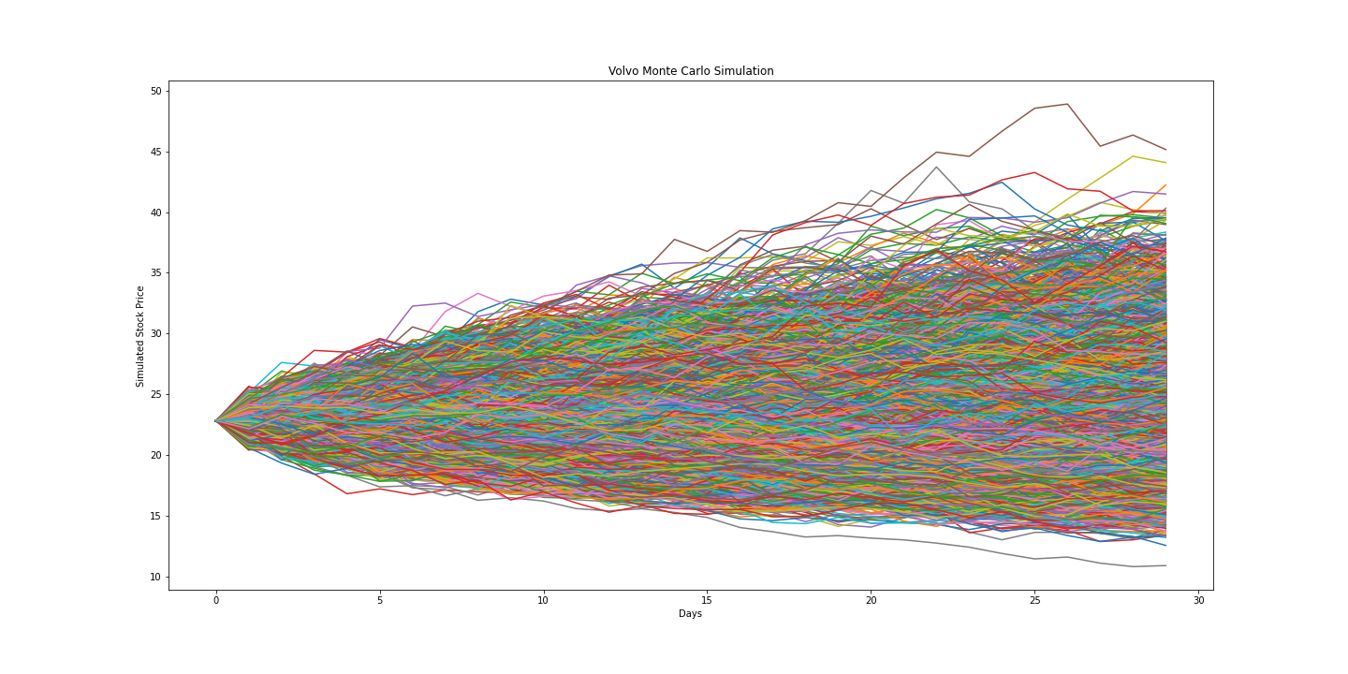

Slide 16
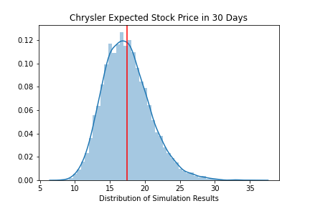
So Which Stock should you invest in?
How we Determined the best stock from our short list:
Whichever stock has the largest delta between current price and the expected price.
Company | Our Prediction | Current Price | Delta
Mercedes | $17.57 | $16.73 | $0.84
GM | $42.69 | $42.86 | $0.17
Volvo | $23.89 | $22.68 | $0.21
Chrysler | $17.43 | $16.12 | $1.31
Notes:
Based on our model, we predict that Chrysler will provide the best investment for the next 30 day period.

Slide 17

Difficulties
Pulling Car Company Tickers
Many car brands fall under parent companies.
Ex: Lincoln is part of Ford; Jeep & Dodge are part of Chrysler
Displaying the data concisely
Large Data Sets
Difficulties figuring out what was important to display.
Notes:
Discuss any difficulties that arose, and how you dealt with them
PULLING TICKERS
American Car companies have many brands under a parent company within the NYSE tickers. It hard to identify individual car companies without knowing if they fell under a parent company.
-DISPLAYING DATA CONCISELY
-Large data sets: 3 regions and 18 car manufacturers.
- determining what was the most important observations to show
-> Which figures would be the most presentable.
We pulled the data and looked at it in multiple types of graphs and had a hard time determining which one would better suited for our audience and the questions we wanted to answer.

Slide 18




Additional questions/
Further analysis
Varying lockdown measures in each region affect the data?
Correlation between electric car companies
Predictive Model Changes
Is there a way to predict stock price with social media presence/sentiment
Notes:
Additional Questions:
LOCKDOWN MEASURES
We would have like to have seen if certain lockdown measure for each region may have affected our data. We know more areas were locked down earlier and for longer periods of time and would have like to have known if that affected their stock price due to their suppliers shutting down and dealerships closed.
ELECTRIC CARS
We would like to do an electric car company comparison to see how Tesla competes with other electric car manufactures like NIO, and Nikola. Tesla stock was such a high return right now, we would would have like to also include other electric companies in our dataset to see how they compared.
PREDICTED MODEL
We would want to make a GUI that would allow user to insert tickers and receive the expected value for a set time parameter.
We would have also liked to had more time to make a more robust simulation model to extended out the predicted forecast from 30 days to 60 days.
SOCIAL MEDIA:
We would like to see how social media plays a role in the stock market. We would like to investigate how information on these social platforms can create a widespread emotional market reaction.

Slide 19
Q & A
Thank you!

